Slide 1

Artificial Intelligence Lecture 04: Problem Solving Through Search
Farhad Muhammad Riaz

Slide 2
Lecture Outline
Agent types
Problem Solving through Search

Slide 3
Utility-based agents
These agents are similar to the goal-based agent but provide an extra component of utility measurement which makes them different by providing a measure of success at a given state.
Utility-based agent act based not only goals but also the best way to achieve the goal.
The Utility-based agent is useful when there are multiple possible alternatives, and an agent has to choose in order to perform the best action.
The utility function maps each state to a real number to check how efficiently each action achieves the goals.

Slide 4
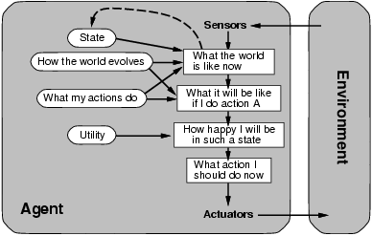
Utility-based agents
Solves the problem of conflicting goals, and quantifies the acquirement of goal

Slide 5
Utility-based Agent
Automated Taxi:
Consider the agent at a crossing, where it can turn right, left, or go straight
The agent will calculate the utility of each such action
It will select the action which maximizes the utility function, i.e., in most cases, the expected profit that the agent can expect to receive in the long run (when the passenger reaches the destination)
E.g., going straight could have highest utility.

Slide 6
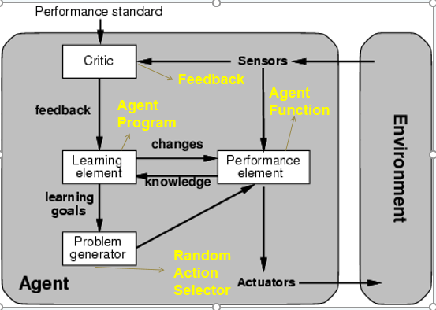
Learning Agents

Slide 7
What is SEARCH?
Suppose an agent can execute several actions immediately in a given state
It doesn’t know the utility of these actions
Then, for each action, it can execute a sequence of actions until it reaches the goal
The immediate action which has the best sequence (according to the performance measure) is then the solution
Finding this sequence of actions is called search, and the agent which does this is called the problem-solver.
NB: Its possible that some sequence might fail, e.g., getting stuck in an infinite loop, or unable to find the goal at all

Slide 8
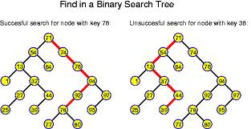
Linking Search to Trees
You can begin to visualize the concept of a graph
Searching along different paths of the graph until you reach the solution
The nodes can be considered congruous to the states
The whole graph can be the state space
The links can be congruous to the actions……

Slide 9
Example: Traveling in Romania
On holiday in Romania; currently in Arad.
Flight leaves tomorrow from Bucharest
Formulate goal: Be in Bucharest
Formulate problem:
States: various cities
Actions: drive between cities
Find solution:
Sequence of cities, e.g., Arad, Sibiu, Fagaras, Bucharest.

Slide 10
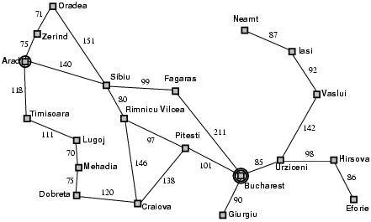
Example: Traveling in Romaniam

Slide 11
Search Problem Types
Static: The configuration of the graph (the city map) is unlikely to change during search
Observable: The agent knows the state (node) completely, e.g., which city I am in currently
Discrete: Discrete number of cities and routes between them
Deterministic: Transiting from one city (node) on one route, can lead to only one possible city
Single-Agent: We assume only one agent searches at one time, but multiple agents can also be used.

Slide 12
Problem-Solver Formulation
A problem is defined by five items:
An Initial state, e.g., “In Arad“
Possible actions available, ACTIONS(s) returns the set of actions that can be executed in s.
A successor function S(x) = the set of all possible {Action–State} pairs from some state, e.g., Succ(Arad) = {<Arad → Zerind, In Zerind>, … }
Goal test, can be
explicit, e.g., x = "In Bucharest
implicit, e.g., Checkmate(x)
Path cost (additive)
e.g., sum of distances, number of actions executed, etc.
c(x,a,y) is the step cost, assumed to be ≥ 0
A solution is a sequence of actions leading from the initial state to a goal state.

Slide 13
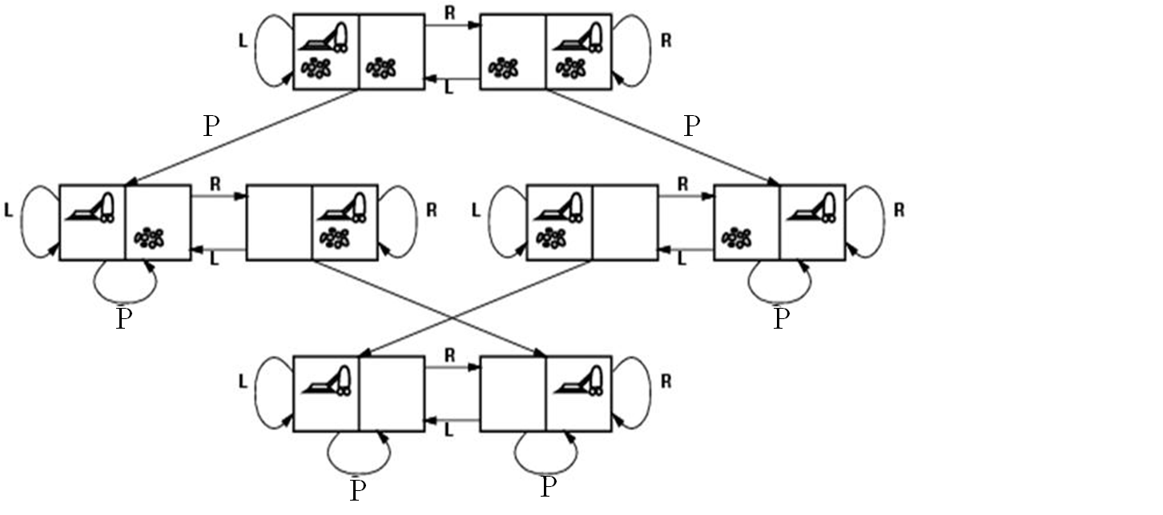
Vacuum World State Space Graph
States? Actions?
Goal test? Path cost?

Slide 14
States? dirt and robot location
Actions? Left, Right, Pick
Goal test? no dirt at all locations
Path cost? 1 per action

Slide 15
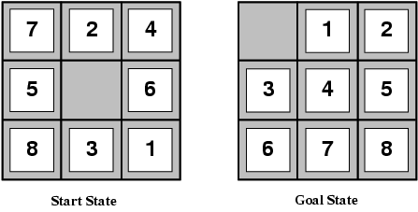
Example: The 8-puzzle
States?
Actions?
Goal test?
Path cost?

Slide 16
States? locations of tiles
Actions? move blank left, right, up, down
Goal test? = goal state (given)
Path cost? 1 per move
[Note: optimal solution of n-Puzzle family is NP-hard]

Slide 17
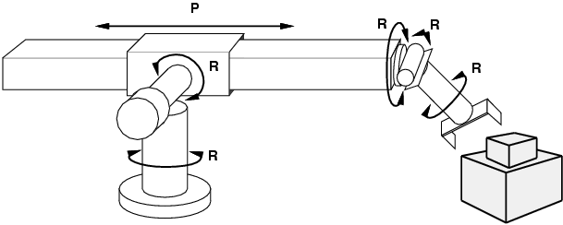
Example: Robotic Assembly
States?: real-valued coordinates of robot joint angles, parts of the object to be assembled, current assembly
Actions?: continuous motions of robot joints
Goal test?: complete assembly
Path cost?: time to execute

Slide 18
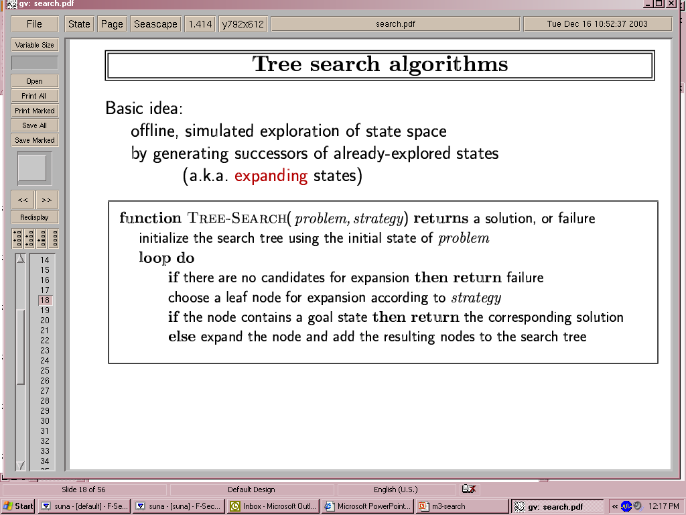
Tree Search Algorithms
Basic idea:
Offline (not dynamic), simulated exploration of state space by generating successors of already-explored states (a.k.a. expanding the states)
The expansion strategy defines the different search algorithms.

Slide 19
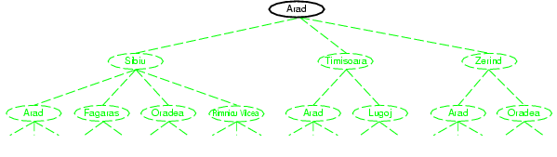
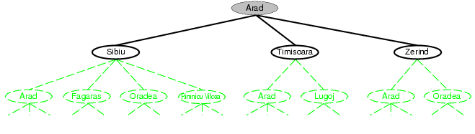
Tree search example

Slide 20
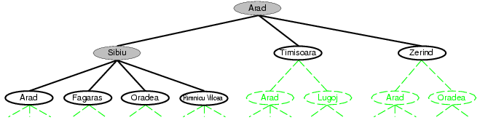

Slide 21
Fringe
Fringe: The collection of nodes that have been generated but not yet expanded
Each element of the fringe is a leaf node, with (currently) no successors in the tree
The search strategy defines which element to choose from the fringe

Slide 22
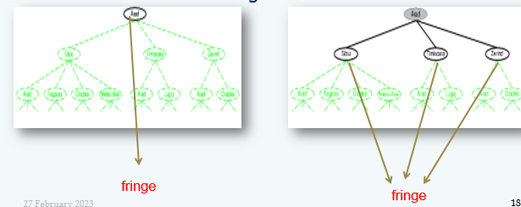
Fringe

Slide 23
Implementation: States vs. Nodes
A state is a representation of a physical configuration
A node is a data structure constituting part of a search tree includes state, parent node, action, path cost g(x), depth
The Expand function creates new nodes, filling in the various fields and using the SuccessorFn of the problem to create the corresponding states.

Slide 24
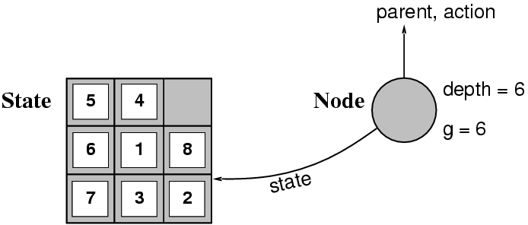
Implementation: States vs. Nodes

Slide 25
Search Strategies
A search strategy is defined by picking the order of node expansion
Strategies are evaluated along the following dimensions:
Completeness: Does it always find a solution if one exists?
Time complexity: Number of nodes generated
Space complexity: Maximum number of nodes in memory
Optimality: Does it always find a least-cost solution?
Time and space complexity are measured in terms of
b: maximum no. of successors of any node
d: depth of the shallowest goal node
m: maximum length of any path in the state space.

